Slide 1

Axon Cars Analysis
Abel

Slide 2

INTRODUCTION
Axon Automobile, a small retailer that sells classic cars, was facing challenges managing and understanding their sales data. The sales team had a hard time making sense of the information, and the management couldn't get accurate and up-to-date sales reports, which made it tough to make important decisions. To fix this problem, Axon decided to use Microsoft Power BI and Python to create a Business Intelligence (BI) tool. Our goal was to help them manage and analyze their sales data in a better way.

Slide 3
METHODOLOGY
We gathered and cleaned relevant data from our sales database, focusing on key metrics such as regional sales, customer segmentation, shipping preferences, product categories, discount impact, and profitability. The data was then visualized using Power BI for a comprehensive analysis. The analysis was conducted using Power BI, a powerful tool for data visualization. Power BI was chosen for its ability to handle large datasets and create insightful visualizations, providing a comprehensive understanding of our business data. We created key measures to compare results and track performance trends over time.

Slide 4

TOOLS USED
Python: To get and preprocess the data.
Power BI: To visualize and analyze the data in a better way.
Excel: For additional data work.

Slide 5
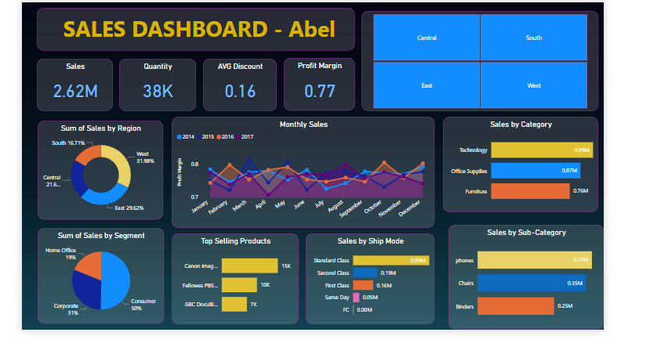
DASHBOARD

Slide 6
FINDING & INSIGHTS
Sales by Region:
The Western region consistently led in total sales, contributing 32% of overall revenue. The East and Central regions closely followed with 30% and 22% each, while the South region accounted for 16% of total sales.
Top Products & Categories:
Products Canon imageCLASS 2200 Advanced Copier and Fellowes PB500 Electric Punch Plastic Comb Binding Machine with Manual Bind emerged as top sellers. In terms of categories, Technology products dominated total sales followed by Office Supplies and Furniture.

Slide 7
FINDING & INSIGHTS
Discount Strategy Impact:
Higher discounts (11-24%) correlated with increased sales. However, most products were sold with discounts ranging from 11% to 16%.
Sales by Sub-Categories:
Phones lead with 0.37M in sales, followed closely by chairs at 0.35M and blinders at 0.25M. These insights guide tailored strategies for each product group, optimizing their impact on overall sales

Slide 8
FINDING & INSIGHTS
Profitability and Efficiency:
The average discount across all sales stood at 16%, contributing to an overall profit margin of 77%. This suggests a balanced approach to discounting while maintaining healthy profitability.
Sales Trends Over Time:
The area chart illustrated a positive sales trend over the past two years, with a notable increase in the last few months. This indicates a growing market and successful sales strategies.

